Slide 1

IKT 590 Spring Master's Thesis
Examining Ant Colony Optimization Performance for Ship Evacuation
Håkon Bakkevig Steinsholt and Daniel Aasen
Supervisors: Morten Goodwin and Ole-Christoffer Granmo, UIA

Slide 2
Outline
Introduction
Problem Statement
Proposed Solution
Results
Conclusion

Slide 3
Introduction
Lives lost during a chaotic evacuation
Using pathfinding algorithms
Ant Colony Optimization
Simulated passengers using a smart phone application

Slide 4
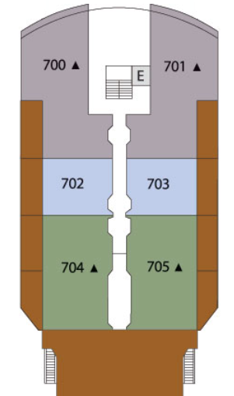
Problem Statement
Creating the simulation environment
Examining the performance of ACO
Comparing ACO to Dijkstra's algorithm

Slide 5
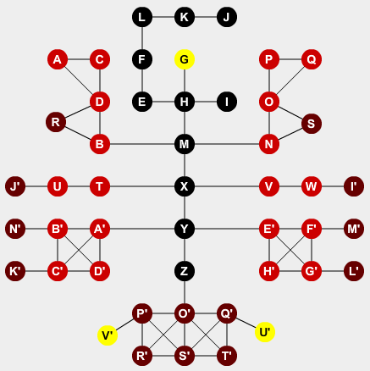
Proposed Solution
Creating the models
Capturing details
Dynamic elements

Slide 6
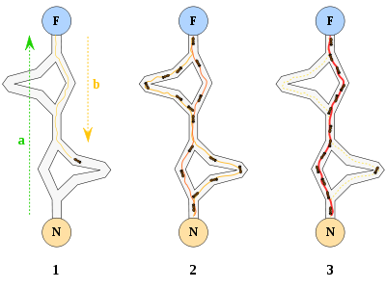
Ant Colony Optimization
Exploring paths
Establishing path
Adapting to change

Slide 7
Parameters used for the simulations
  Number of passengers
  Passenger movement speed
  Passenger chance of panic
  Number and speed of hazzards

Slide 8
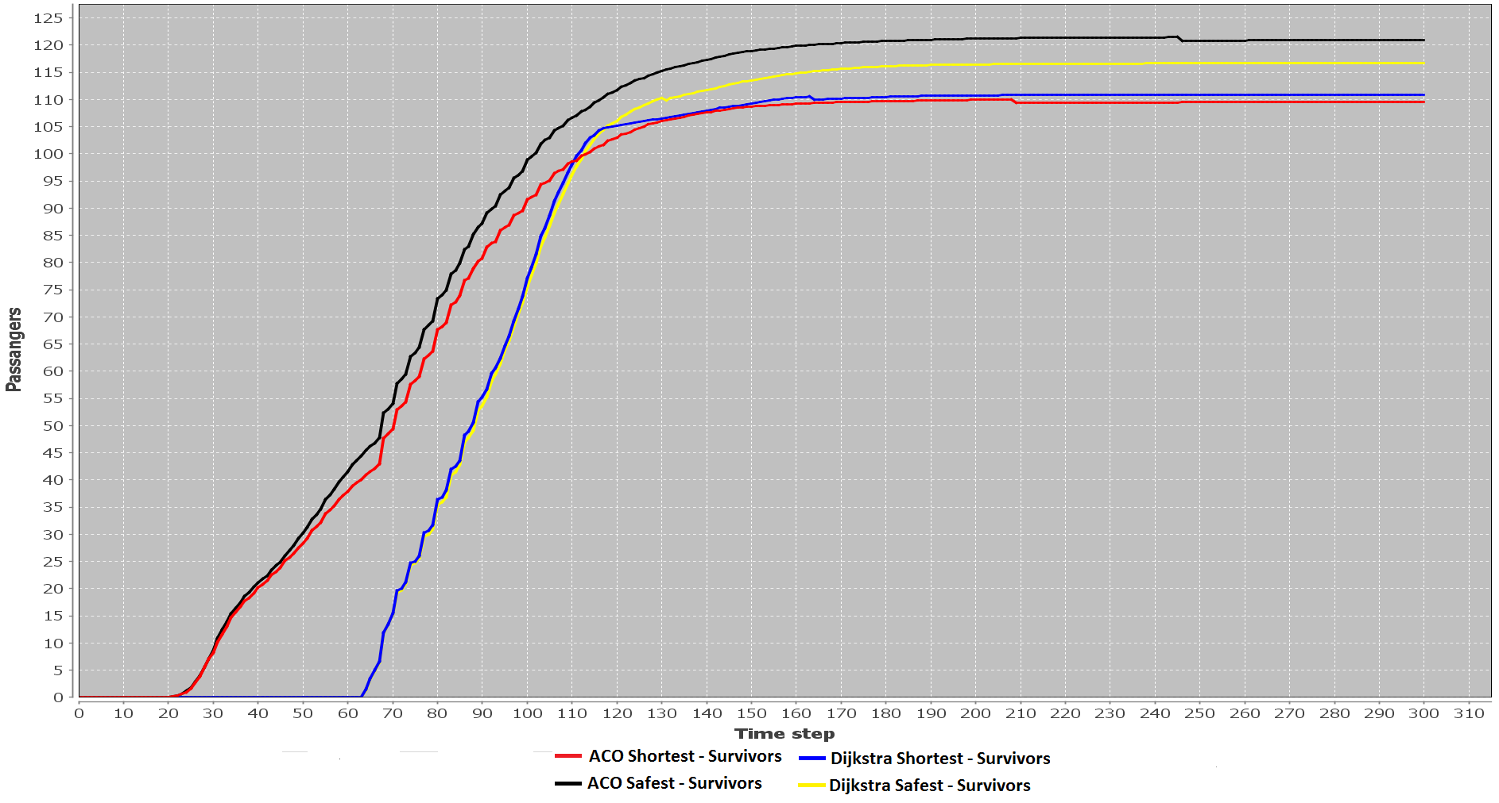
Results – Dijkstra only running at start

Slide 9
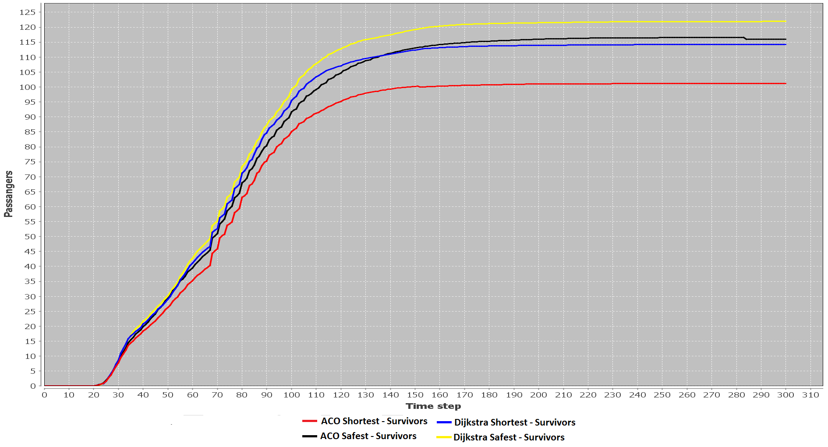
Results – Dijkstra running at every time step

Slide 10
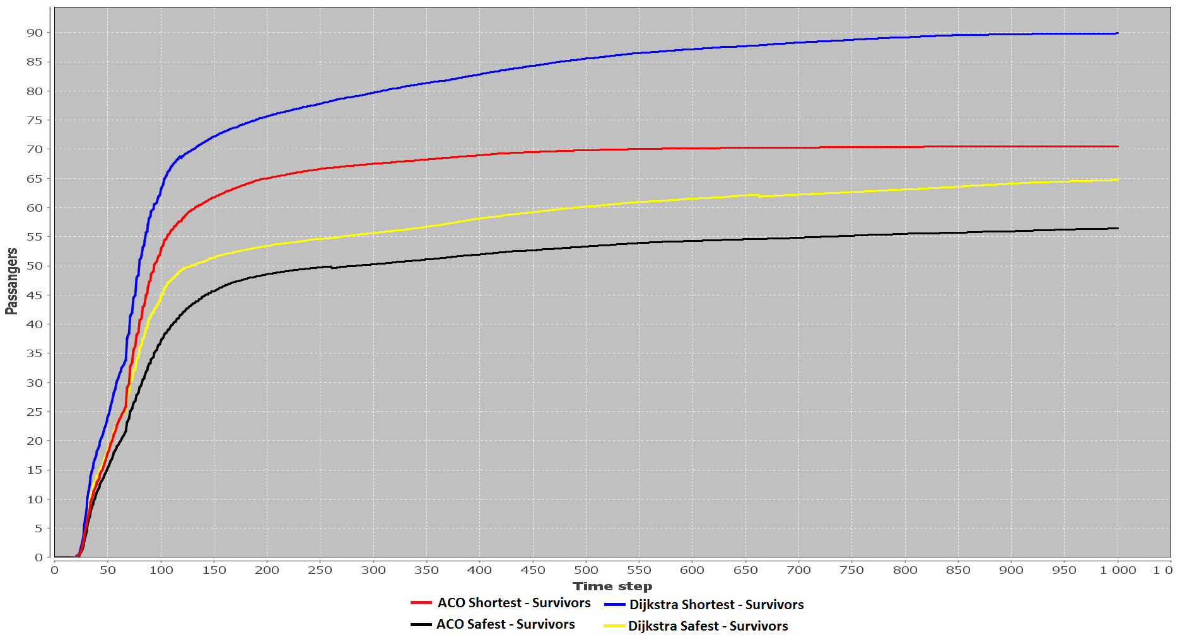
Results – Increased chance of panic

Slide 11
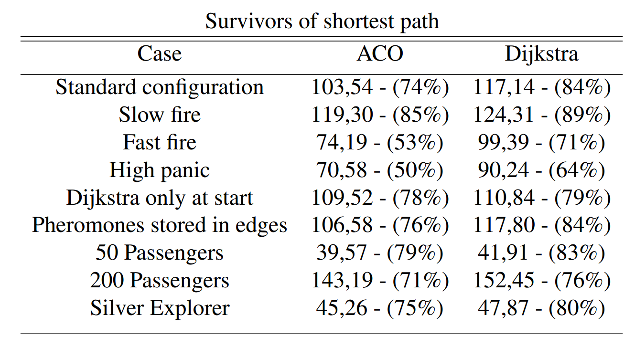
Results – Table with shortest path taken

Slide 12
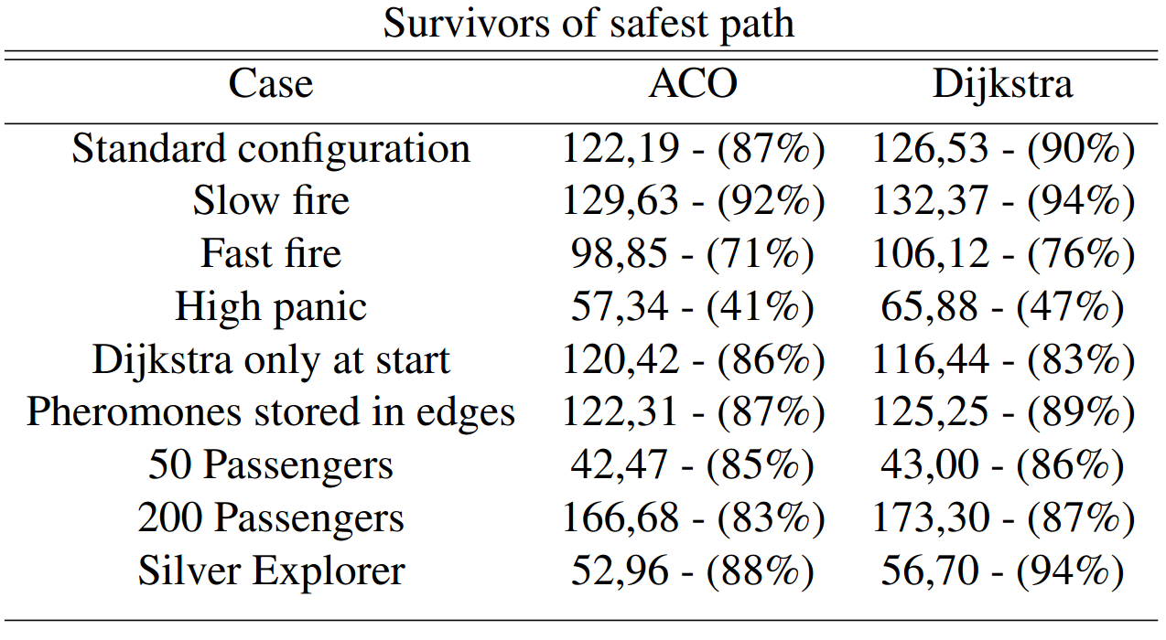
Results – Table with safest path taken

Slide 13
Conclusion
ACO performance approaches that of Dijkstra's algorithm
ACO is the faster algorithm when configured correctly

Slide 14
Future work
Parse blueprints into ship models
Not all passangers have smart phones
Involving the personnel

Slide 15
Bibliografi
Department of Computer Science and Engineering, Yangzhou University. 2009. First Order Deceptive Problem of Ant Colony Optimization Algorithm . [report] Yangzhou: Huangshan, P. R . China , August 21-23 , 2009, p.4.
Department of Statistics and Decision Support Systems University of Vienna. n.d.. First Steps to the Runtime Complexity Analysis of Ant Colony Optimization. [report] Vienna: p.19.
Neumann, F., Sudholt, D. and Witt, C. n.d.. Computational Complexity of Ant Colony Optimization and Its Hybridization. [report] p.31.

